Slide 1

Pub\Sub Messenger for Unity
https://supermax.github.io/pubsub
SuperMaxim.com

Slide 2
The Problem:
Wiring the Parts with Events – Tightly Coupled and may cause Memory Leak problems. The Publisher and the Subscriber have to know of each other, and a Subscriber can't be collected by the GC if it's connected with the Publisher with strong event reference.
Using Unity Event Routing – Although Unity Event Routing is a very good feature, it is a Unity Specific Solution and we need a generic one. Also, we cannot use it everywhere even if the project is in Unity.
< TBD – Code Example + Unity Example >

Slide 3
The Solution:
Custom Pub\Sub Messenger - Container for Events that allows Decoupling of Publishers and Subscribers so they can evolve independently. This Decoupling is useful in Modularized Applications because new modules can be added that respond to events defined by the Shell or, more likely, other modules. All events have a Weak Reference and invocation can be done Async or Sync way.
< TBD – Code Example + Unity Example >

Slide 4
Event Routing by Pub\Sub Messenger
Publisher
Event Messenger
Subscriber 2
Subscriber 1
Filtered Subscription
Subscriber 3

Slide 5
Use Cases for Pub\Sub Messenger:
Pass Payload between disconnected/independent parts of code;
Thread Safe Invocation of Events between disconnected/independent parts of code;
Asynchronous Invocation of Events between disconnected/independent parts of code;
Filtered Invocation of Events between disconnected/independent parts of code;
Obfuscated Invocation of Events between disconnected/independent parts of code;

Slide 6
Messenger API:
Messenger
Implements this basic interface:
/// <summary>
/// Interface for Pub/Sub Messenger
/// </summary>
public interface IMessenger
{
/// <summary>
/// Publish given payload to relevant subscribers
/// </summary>
/// <param name="payload">Instance of payload to publish</param>
/// <typeparam name="T">The type of payload to publish</typeparam>
void Publish<T>(T payload);
/// <summary>
/// Subscribe given callback to receive payload
/// </summary>
/// <param name="callback">The callback that will receive the payload</param>
/// <param name="predicate">The predicate to filter irrelevant payloads (optional)</param>
/// <typeparam name="T">The type of payload to receive</typeparam>
void Subscribe<T>(Action<T> callback, Predicate<T> predicate = null);
/// <summary>
/// Unsubscribe given callback from receiving payload
/// </summary>
/// <param name="callback">The callback that subscribed to receive payload</param>
/// <typeparam name="T">Type of payload to unsubscribe from</typeparam>
void Unsubscribe<T>(Action<T> callback);
}

Slide 7
Messenger API:
Messenger
Access to default Messenger instance via: Messenger.Default
Publish
Messenger.Default.Publish<Payload>(new Payload{ /* payload params */ });
Payload – the payload that will be published to subscribers of this type

Slide 8
Messenger API:
Subscribe
Messenger.Default.Subscribe<Payload>(Callback);
Payload – the type of Callback parameter
Callback – delegate (Method) that will receive payload
private static void Callback(Payload payload)
{
// Callback logic
}
Subscribe with Predicate
Messenger.Default.Subscribe<Payload>(Callback, Predicate);
Predicate – delegate (Function) that will receive payload to filter
private static bool Predicate(Payload payload)
{
// Predicate filter logic
// if function will return ‘false’ value, the Callback will not be invoked
return accepted;
}

Slide 9
Messenger API:
Subscribe
Messenger.Default.Unsubscribe<Payload>(Callback);
Payload – the type of Callback parameter
Callback – delegate (Method) that will be removed from subscribers

Slide 10
Tips for Correct Usage:
DON’T use Messenger if you have quick access to shared code parts to invoke events/methods in same module/class;
ALWAYS ensure that you unsubscribe when you’re done with consuming of shared payloads;
DON’T publish events in endless loop;
PREFERE using Filtered subscriptions;

Slide 11
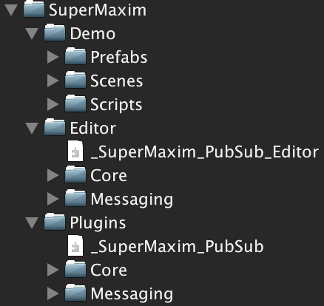
Package Structure:
Folders
Demo (sample) files
Editor scripts
Runtime scripts
Folders:
Core – base classes and scripts that are not specific for Messenger
Messaging – classes and scripts that are specific for Messenger

Slide 12
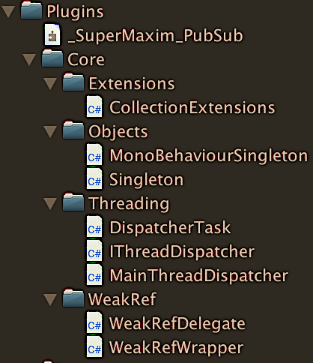
Package Structure:
Plugins / Core
Folder | File/Class/Script | Description
Extensions | CollectionExtensions | Static class with collection extension functions
Objects | MonoBehaviourSingleton | Abstract base class for MB singletons
Objects | Singleton | Abstract base class for classic singletons
Threading | DispatcherTask | Task unit with weak ref. (pointer) to delegate to execute on main thread
Threading | IThreadDispatcher | Interface for Thread Dispatcher API
Threading | MainThreadDispatcher | Singleton class that implements IThreadDispatcher and provides API to sync tasks between main thread and other threads
WeakRef | WeakRefDelegate | Weak reference for delegate (inherits from WeakRefWrapper)
WeakRef | WeakRefWrapper | Weak reference wrapper (disposable)
Folders:
Extensions – extensions classes
Objects – core base classes
Threading – multithreading related classes/scripts
WeakRef – weak reference handling classes

Slide 13
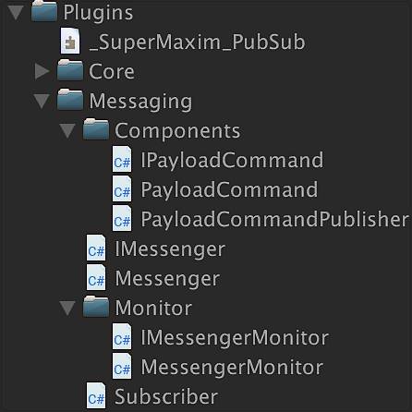
Package Structure:
Plugins / Messaging
Folder | File/Class/Script | Description
Messaging / Components | IPayloadCommand | Interface for Payload Command – a generic payload with Id and Dic. of string key value pair Data
Messaging / Components | PayloadCommand | Implementation of generic Payload Command, implementing IPayloadCommand interface
Messaging / Components | PayloadCommandPublisher | MB Script with Publish method that publishes a generic PayloadCommand – can be used with UGUI events or other ways
Messaging | IMessenger | Interface for Messenger API
Messaging | Messenger | Implementation of IMessenger interface with Pub-Sub logic; contains container of subscribers; singleton that is accessible via Messenger.Default
Messaging | Subscriber | Represents single item for subscribers’ container. Including weak ref. pointing to callback method and weak ref. pointing to predicate.
Messaging / Monitor | IMessengerMonitor | Interface for MessengerMonitor API
Messaging / Monitor | MessengerMonitor | Debugging and monitoring tool for Messenger
Folders:
Components – useful unity components
Monitor – debugging and monitoring tools

Slide 14
DEMO – Game Chat:
Goals:
Show basic usage of Messenger;
Use real world example – Chat between players;
Include examples of message filtering and multithreading;
Show “Best Practices” approach in implementation;

Slide 15
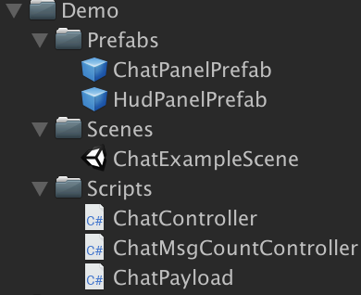
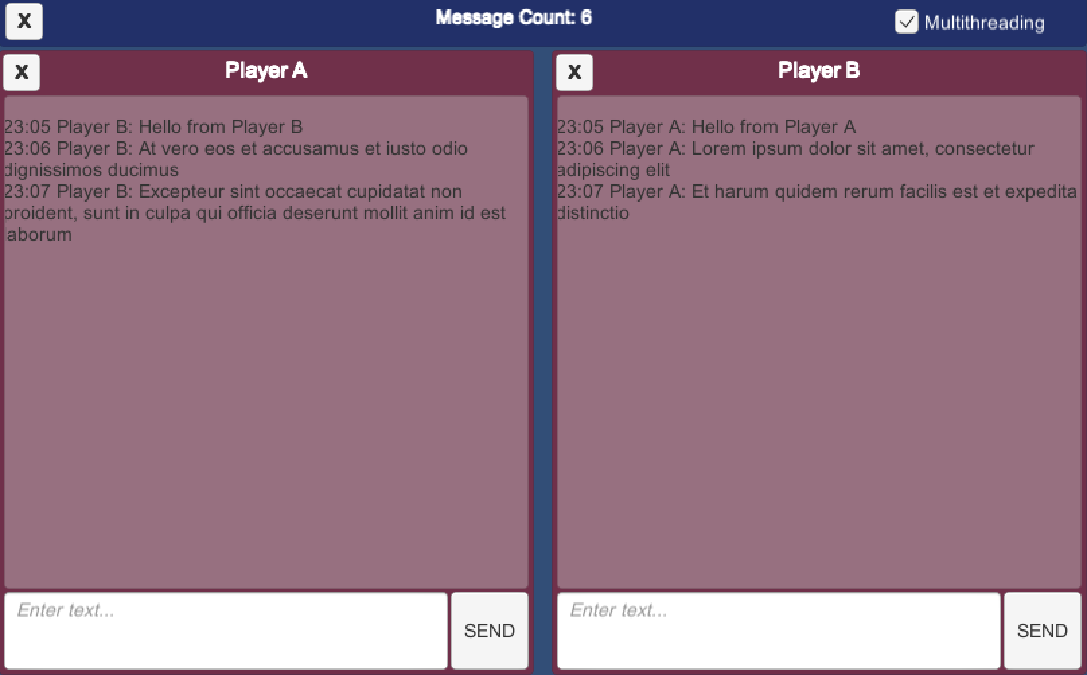
Demo Structure:
Demo
Folder | File/Class/Script | Description
Prefabs | ChatPanelPrefab | Prefab that contains all elements for player chat UI (see prefab in editor)
Prefabs | HubPanelPrefab | Prefab that contains top HUD elements (see prefab in editor)
Scenes | ChatExampleScene | Example scene with chat UI (see scene in editor)
Scripts | ChatController | Script that controls ChatPanelPrefab (message input, publish and subscribe)
Scripts | ChatMsgCountController | Scripts that ‘listens’ to chat messages, counts them and displays count in HUD
Scripts | ChatPayload | Payload class that is used to pass messages between chat panels
HudPanelPrefab
ChatPanelPrefab

Slide 16
Chat Controller:
Implements this basic interface:
TBD

